Slide 1
How do we estimate things?
Specify a model
Function generating predictions
Identify plausible values for any unknown parameters
Maximize probability of observations given function
Assess uncertainty
Explore function around plausible values

Slide 2
Tres problemas con GLM que hemos encontrado

Slide 3
1. Seleccion de celdas para indices
mod = glm(CPUE ~ as.factor(Year) + as.factor(Cell),
family = poisson(link = "log"),
data = haul_data)
pred_data <- data.frame(Year = 1:nyrs, Cell = 1)
pred <- predict(mod,
newdata = pred_data,
type = "response", se = TRUE)

Slide 4
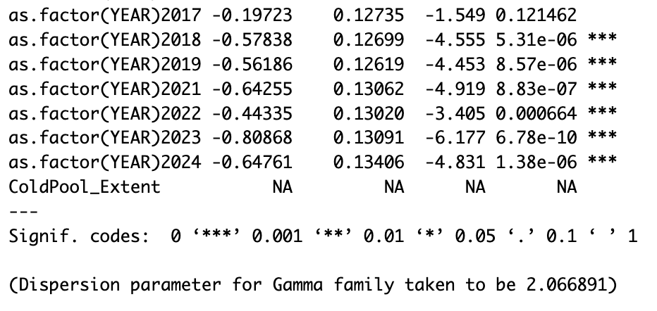
Modelos con predictores del grupo
Lab 3:
mod <- glm(CPUE_KGKM2 ~ as.factor(YEAR) + ColdPool_Extent,
data = Yellowfin,
family = binomial(link = "logit"))
summary(mod)
Do not converge!!

Slide 5
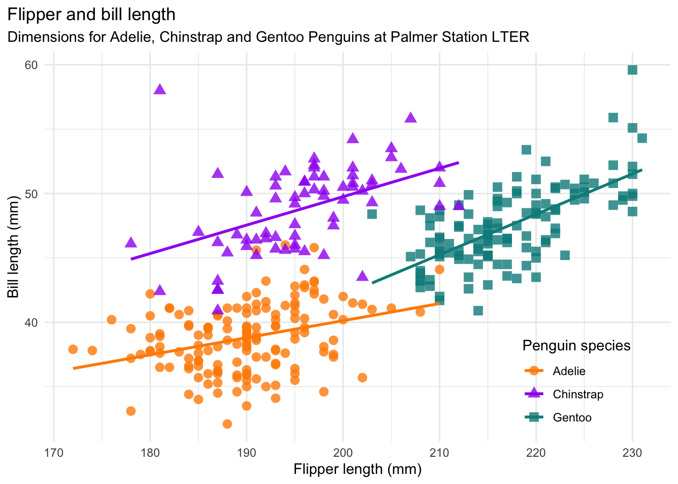

Prediccion del nuevo grupo
https://allisonhorst.github.io/palmerpenguins/

Slide 6
Prediccion del nuevo grupo
https://allisonhorst.github.io/palmerpenguins/
?
?
?

Slide 7
Modelos Jerárquicos!!

Slide 8
Modelos Jerárquicos: Descripción General
Clase de modelos con una estructura jerárquica
Conocidos tb con otros nombres:
Modelos con efectos aleatorios (efectos mixtos)
Modelos de Estado-Espacio (State-space)
Modelos de niveles-múltiples (Multi-level)
Jerarquías ocurren naturalmente: individuos dentro de los sitios, subpoblaciones dentro de poblaciones, etc.
Muchas formas de visualizar esta clase de modelos, pueden se conceptualmente difíciles y abrumadores
Royle and Dorazio 2008

Slide 9
Random effects (classic regression)
Problem:
We often have structured data that needs to be accounted for
Examples:
Small sample size
Estimates from groups with smaller sample sizes will have less information and more variable. Random effects allow information to be shared across groups.
Nuisance variables
There are often structures in our data that impact the outcome, that we do not necessarily care about (e.g. vessel effects)
Correlation structure
Data collected from the same individuals or close in time/space will be correlated. Not accounting for that correlation structure will produce overly precise confidence intervals

Slide 10
Random effects (population modelling)
Problem:
We often can’t write the probability of data given parameters
Examples:
Tag-recapture
What’s the probability of tagging an animal in 2008, seeing it again in 2010 and 2011, and then never seeing it again?
Time-series
What’s the probability distribution for escapement of chinook salmon in the snake river in 2011, given that you’ve sampled escapement from 1980-2010?
Occupancy
Three volunteers look for an endangered butterfly at a site, and only two find it. These volunteers sample at a new site, and none see the butterfly. What is the probability that is present but wasn’t detected?

Slide 11
HM por Royle & Dorazio
Los modelos estadísticos son ampliamente utilizados en ecología
Una “aproximación conceptual y filosófica para hacer ciencia” con modelos distintivos:
Observación: Como son observados los datos (con error), dado el proceso.
Proceso: Describe la dinámica de los procesos ecológicos (e.g. abundancia animal en espacio/tiempo)
P(datos|procesos, parámetros)*P(procesos|parámetros)
observaciones
procesos
Royle and Dorazio 2008

Slide 12
HM: Thorson and Minto
Muchos modelos estiman características biológicas no observables
Estos “estados latentes” conllevan a residuos correlacionados
E.g., densidades muestreadas más cerca en espacio o tiempo serán más similares que si estuvieran más distantes
Esto viola el supuesto de independencia de los modelos no jerárquicos (e.g., LM, GLM).
Los modelos jerárquicos (efectos-mixtos) son una solución genérica en estas situaciones
Efectos aleatorios = “se asume que los parámetros provienen de un proceso estocástico común”
Thorson and Minto 2014

Slide 13
Ajustando modelos Jerárquicos
Enfoque frecuentista o bayesiano
El ajuste requiere de la integración de los efectos aleatorios
La integración en casos de alta dimensión es difícil, asi que históricamente no se usaba
… hasta el advenimiento de paquetes Bayesianos como JAGS
Aproximaciones frecuentistas integran utilizando la “Aproximación de Laplace”
Nosotros utilizaremos RTMB o R para ajustar modelos jerárquicos

Slide 14
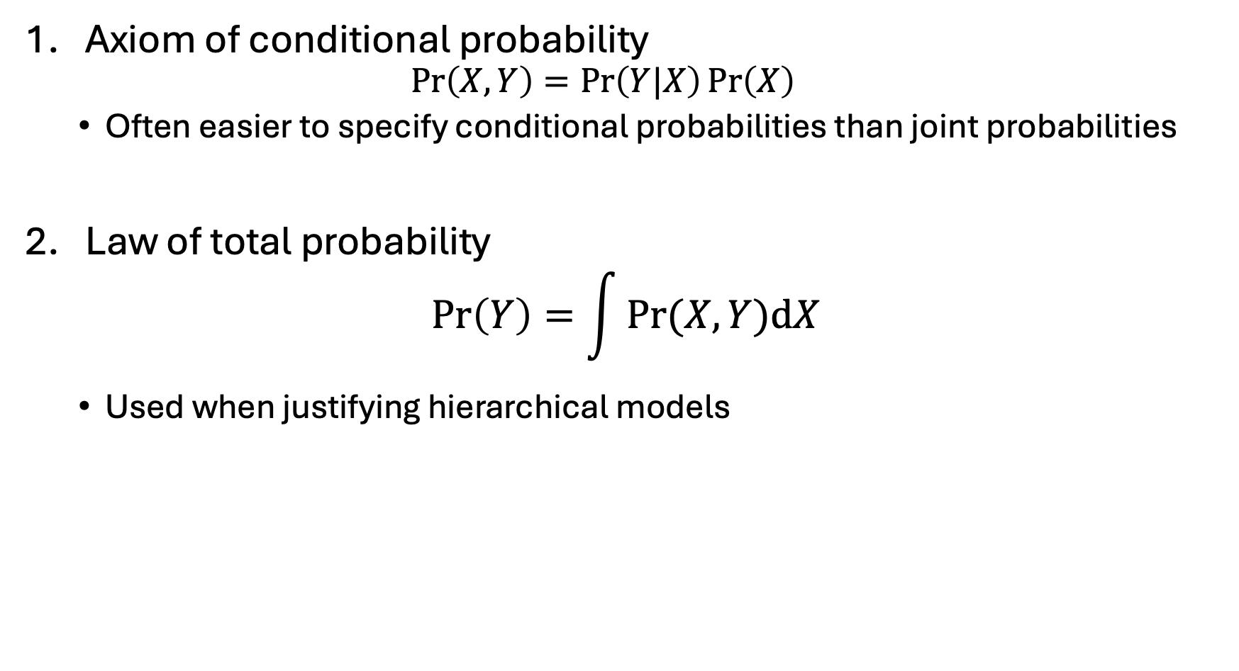
Laws of probability
Axiom of conditional probability
$$\operatorname{Pr}\left(X,Y\right)=\operatorname{Pr}\left(Y|X\right)\operatorname{Pr}\left(X\right)$$
Often easier to specify conditional probabilities than joint probabilities
Law of total probability
$$\operatorname{Pr}\left(Y\right)=\int{Pr⁡(X,Y)dX}$$
Used when justifying hierarchical models

Slide 15
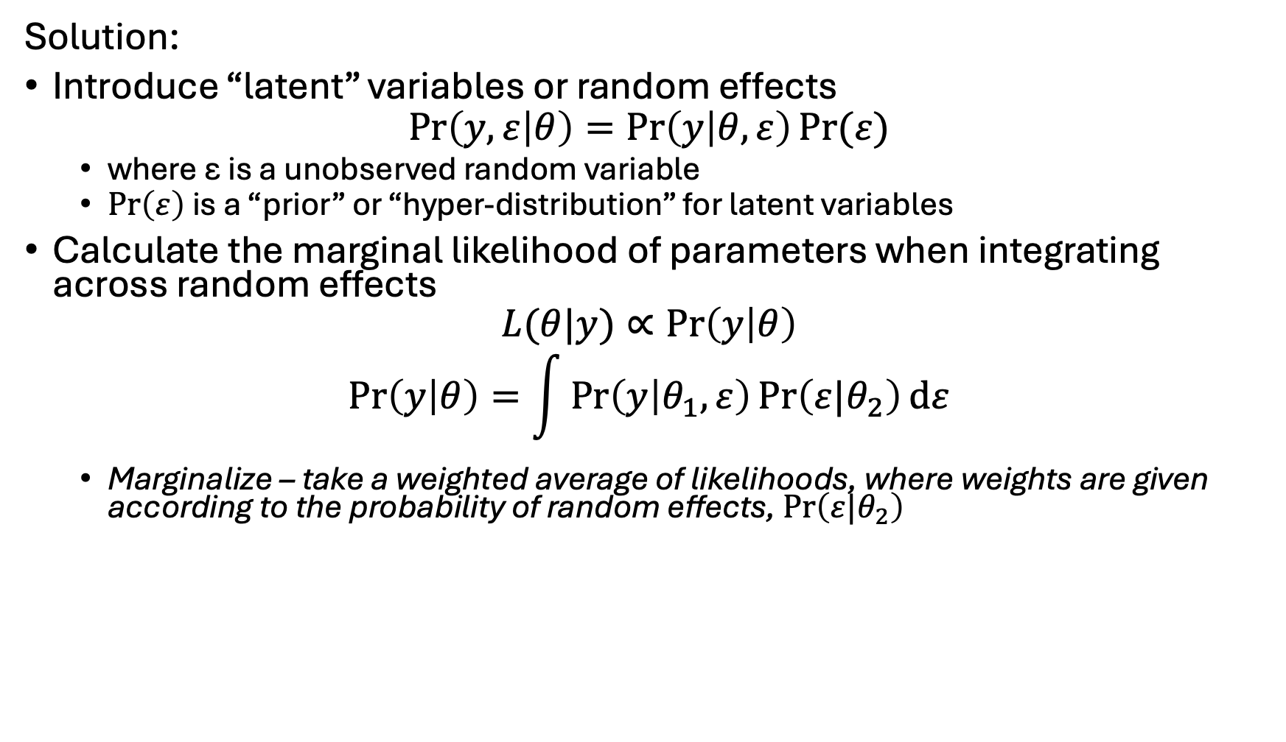
Random effects likelihood
Solution:
Introduce “latent” variables or random effects
$$\operatorname{Pr}\left(y,ε | θ\right)=\operatorname{Pr}\left(y | θ,ε\right)Pr⁡(ε)$$
where ε is a unobserved random variable
$\operatorname{Pr}\left(ε\right)$ is a “prior” or “hyper-distribution” for latent variables
Calculate the marginal likelihood of parameters when integrating across random effects
$$L(θ|y)∝\operatorname{Pr}\left(y | θ\right)$$
$$\operatorname{Pr}\left(y | θ\right)=\int{\operatorname{Pr}\left(y | θ_{1},ε\right)\operatorname{Pr}\left(ε|θ_{2}\right)dε}$$
Marginalize – take a weighted average of likelihoods, where weights are given according to the probability of random effects, $\operatorname{Pr}\left(ε|θ_{2}\right)$

Slide 16
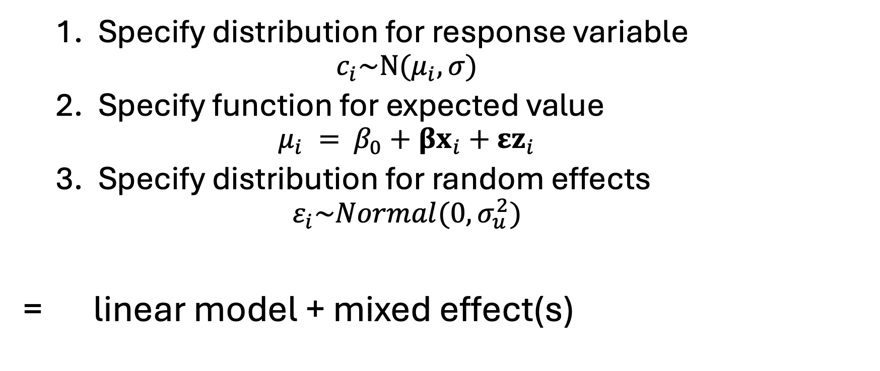
Linear mixed model
Specify distribution for response variable
$$c_{i}\sim N(μ_{i}, σ)$$
Specify function for expected value
$$μ_{i} =⁡β_{0}+βx_{i}+εz_{i}$$
Specify distribution for random effects
$$ε_{i}\sim Normal(0,σ_{u}^{2})$$
= linear model + mixed effect(s)

Slide 17
Mixed-effects models
Fit using R
Using lme4 package
formula: way to specify model
Linear model – lm(formula= … )
Count ~ x + factor(Site)
“Count” – response variable
“factor(Site)” – Include a fixed effect for each site
Linear mixed model – lm(formula = … | … )
Count ~ x + ( 1 | factor(Site))
“( 1 | factor(Site) )” – Include a random intercept for each site
“( x - 1 | factor(Site) )” – Include a random slope for each site
“( x | factor(Site) )” – Include a random intercept AND slope for each site

Slide 18
Term | Definition
Random effect | Coefficient that is “exchangeable” with one or more other coefficients
Hyperdistribution | Distribution for “exchangeable” random effects
Exchangeable | No information is available to distinguish between residual variability in random effects
Fixed effect | Coefficient that is not exchangeable with others, and which hence is estimated without a hyperdistribution
Mixed-effect model | Model with both fixed and random effects

Slide 19

Random intercepts
$$y_{i}=a_{group}+b∗x+ε_{i}$$
$$a_{group}\sim Normal(\overline{a},σ_{a}^{2})$$
$$ε_{i}\sim Normal(0,σ^{2})$$

Slide 20
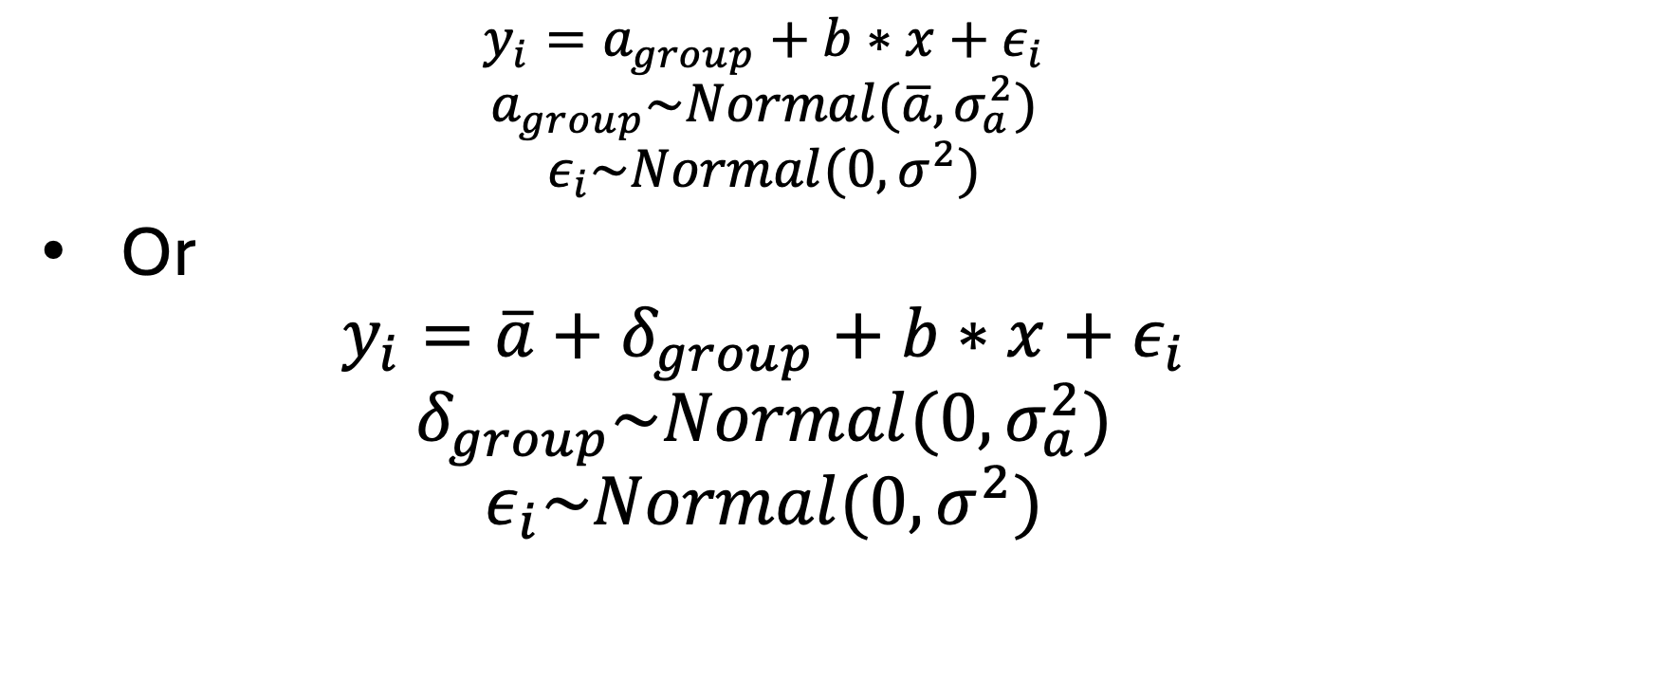
Random intercepts
$$y_{i}=a_{group}+b∗x+ε_{i}$$
$$a_{group}\sim Normal(\overline{a},σ_{a}^{2})$$
$$ε_{i}\sim Normal(0,σ^{2})$$
Or
$$y_{i}=\overline{a}+δ_{group}+b∗x+ε_{i}$$
$$δ_{group}\sim Normal(0,σ_{a}^{2})$$
$$ε_{i}\sim Normal(0,σ^{2})$$

Slide 21
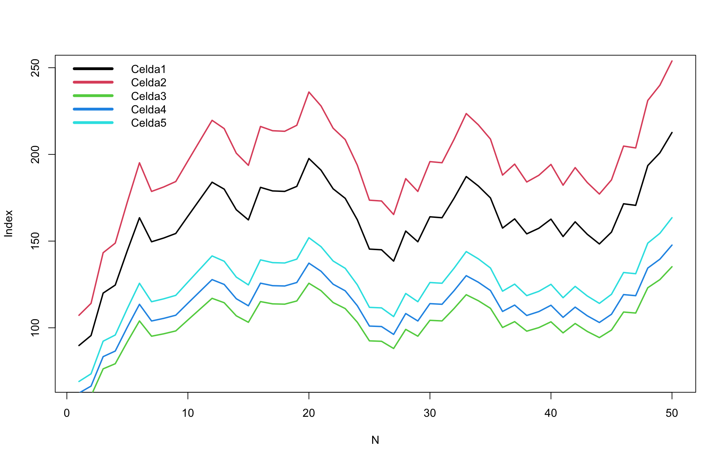
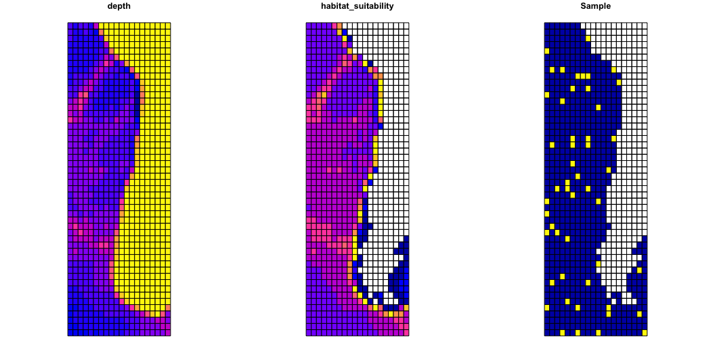

Slide 22
Random intercepts
[See workshop6_random_intercepts.R]

Slide 23

Random slopes
$$y_{i}=a+b_{group}∗x+ε_{i}$$
$$b_{group}\sim Normal(\overline{b},σ_{b}^{2})$$
$$ε_{i}\sim Normal(0,σ^{2})$$

Slide 24
Random slopes
[See workshop7_random_slopes.R]

Slide 25
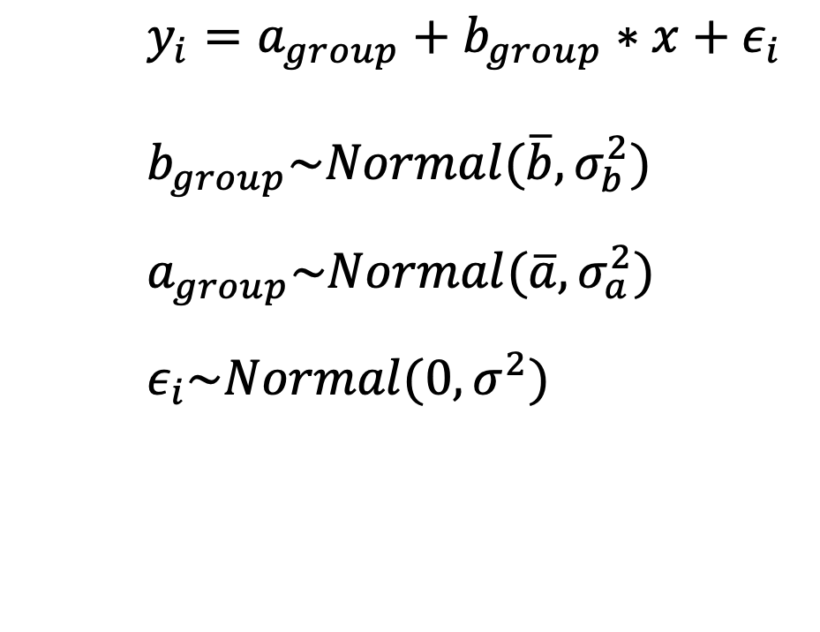
Random slopes and intercepts
$$y_{i}=a_{group}+b_{group}∗x+ε_{i}$$
$$b_{group}\sim Normal(\overline{b},σ_{b}^{2})$$
$$a_{group}\sim Normal(\overline{a},σ_{a}^{2})$$
$$ε_{i}\sim Normal(0,σ^{2})$$

Slide 26
Random slopes and intercepts
[See workshop8_random_slopes.R]

Slide 27
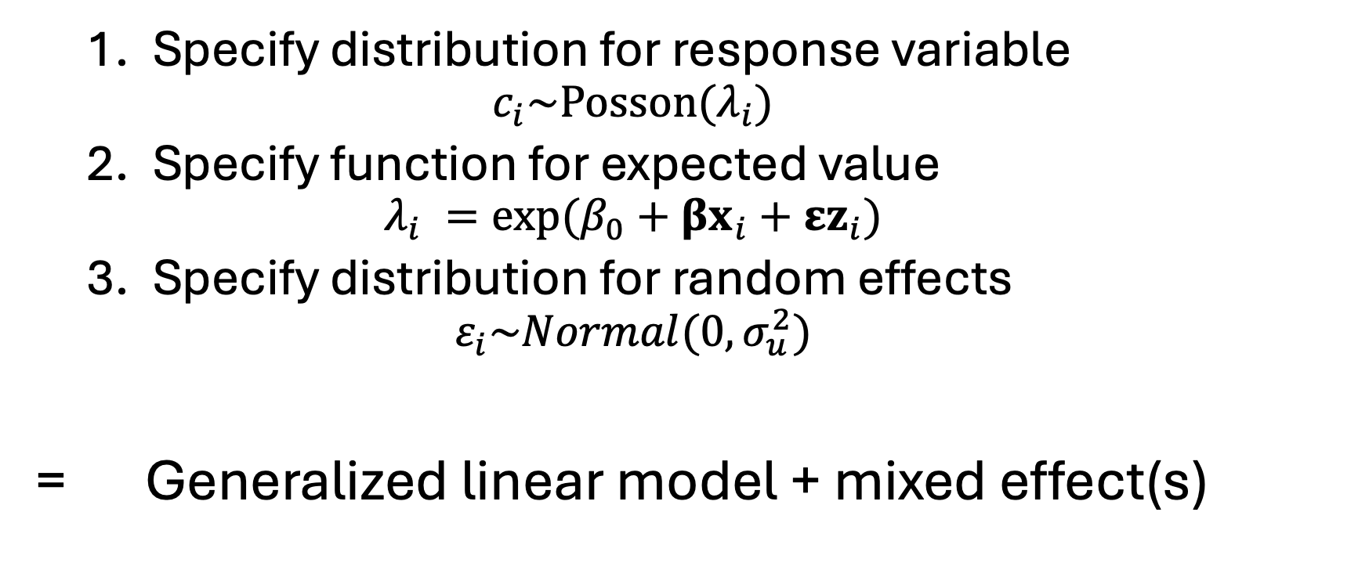
Generalized linear mixed model
Specify distribution for response variable
$$c_{i}\sim Posson(λ_{i})$$
Specify function for expected value
$$λ_{i} =exp⁡(β_{0}+βx_{i}+εz_{i})$$
Specify distribution for random effects
$$ε_{i}\sim Normal(0,σ_{u}^{2})$$
= Generalized linear model + mixed effect(s)

Slide 28
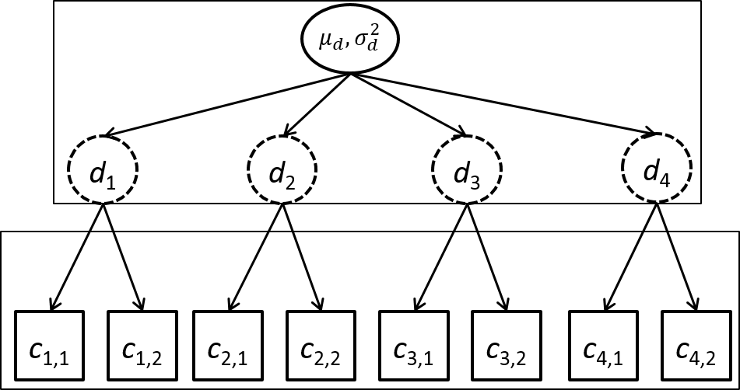
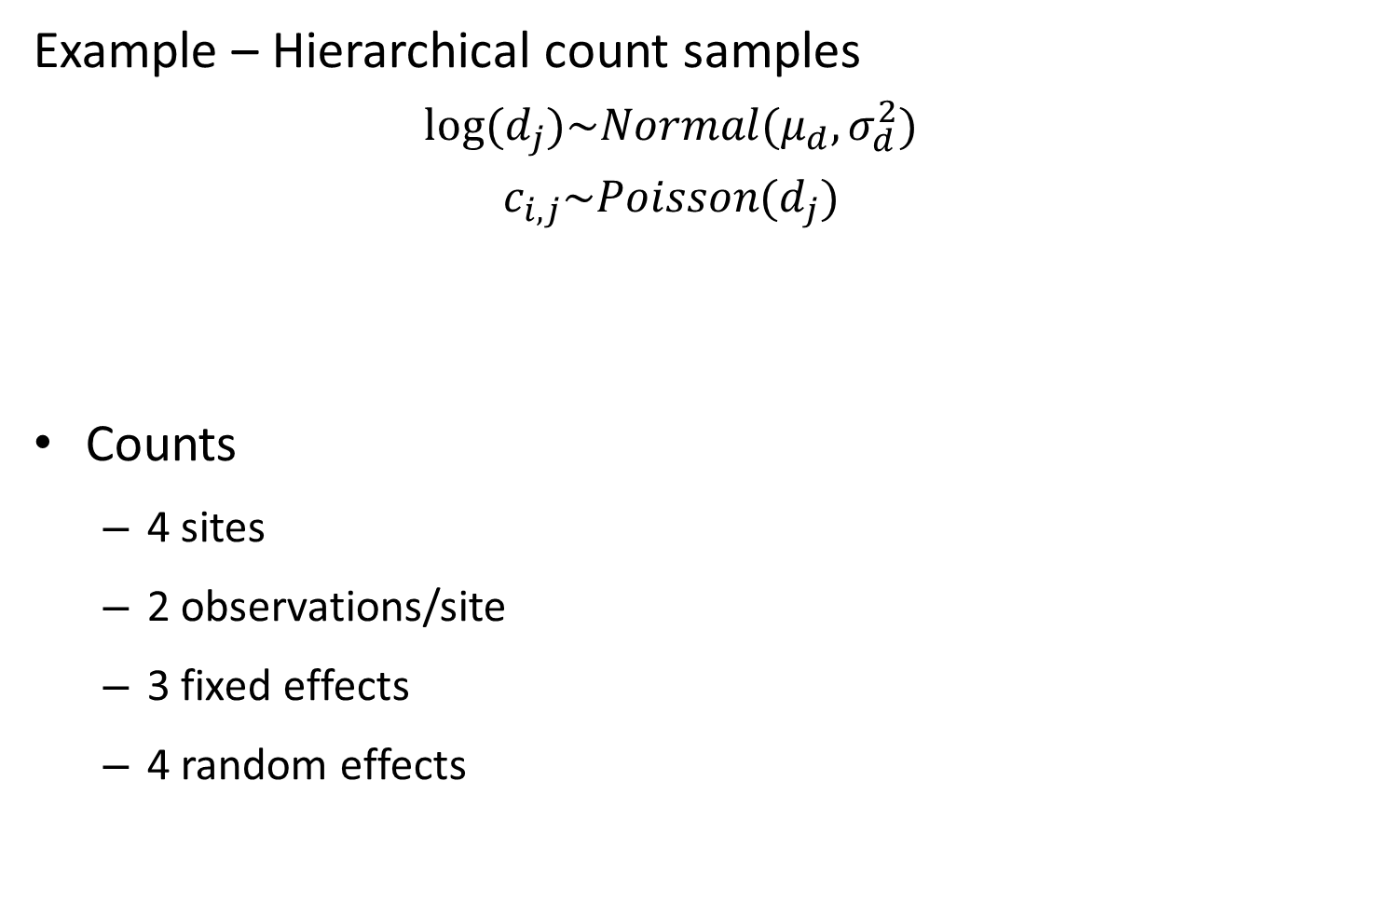
Mixed-effects models
Example – Hierarchical count samples
$$log⁡(d_{j})\sim Normal(μ_{d},σ_{d}^{2})$$
$$c_{i,j}\sim Poisson(d_{j})$$
Counts
4 sites
2 observations/site
3 fixed effects
4 random effects

Slide 29
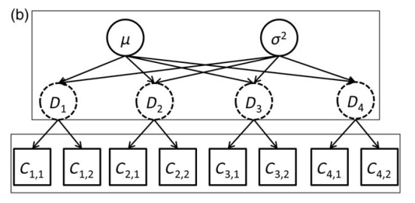
Modelos jerárquicos: ejemplos
Densidad media y variabilidad entre sitios
Densidad en 4 sitios
Conteos observados en 2 evaluaciones en cada sitio
La densidad en los sitios está relacionada (dependiente)
La densidad en los sitios no es directamente observada (latent)
Thorson and Minto 2014

Slide 30
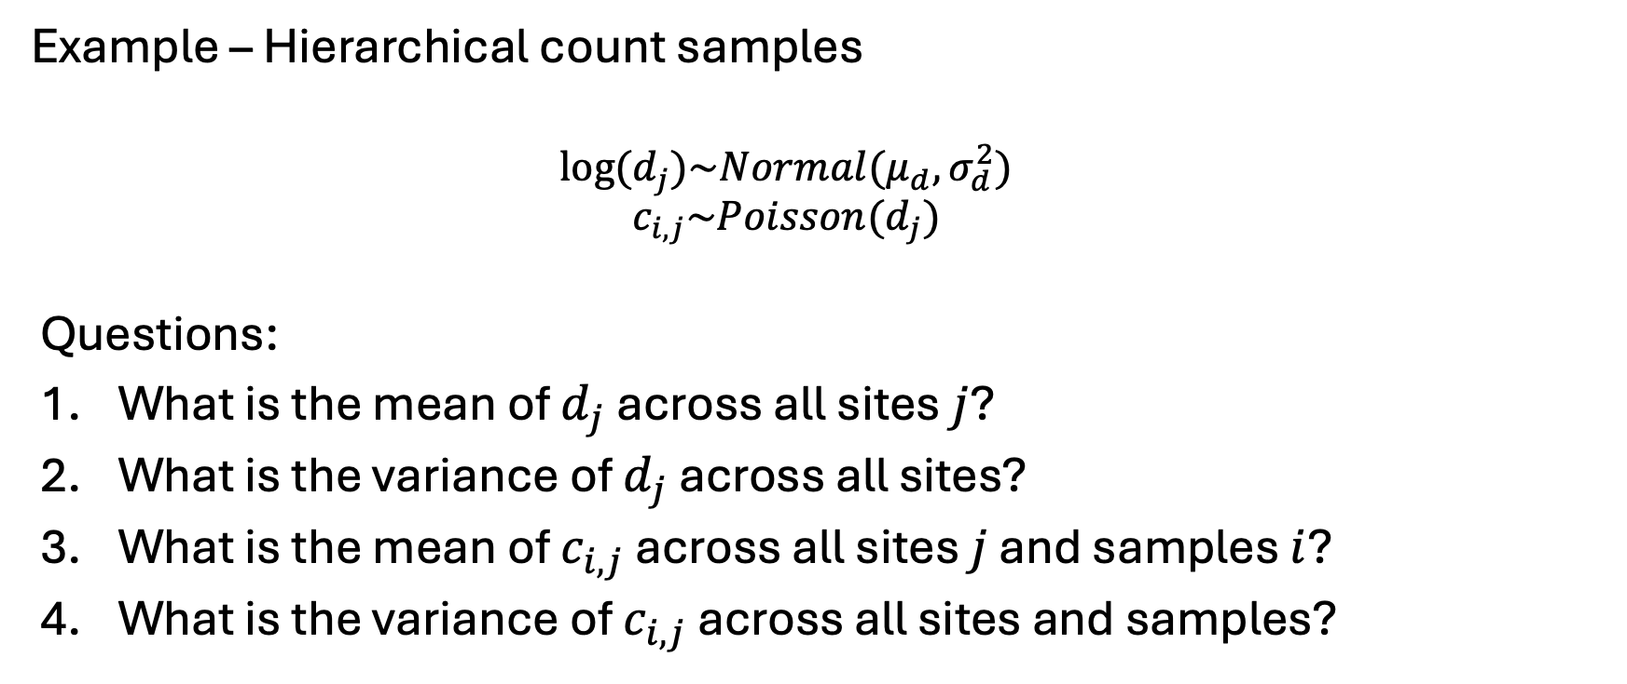
Mixed-effects models
Example – Hierarchical count samples
$$log⁡(d_{j})\sim Normal(μ_{d},σ_{d}^{2})$$
$$c_{i,j}\sim Poisson(d_{j})$$
Questions:
What is the mean of $d_{j}$ across all sites $j$?
What is the variance of $d_{j}$ across all sites?
What is the mean of $c_{i,j}$ across all sites $j$ and samples $i$?
What is the variance of $c_{i,j}$ across all sites and samples?

Slide 31
Mixed-effects models
Simulating data
[See R code]

Slide 32
Revisión de conceptos claves
Los modelos jerárquicos contienen efectos aleatorios
Ocurren amplia y naturalmente en ecología
Es una forma útil de modelar nuestros datos
Requiere de la integración de efectos aleatorios

